Slide 1
Imagine the Internet and more on SMS
txtWeb
Gaurav Bhatia
Product Development Leader
Visit us at www.txtWeb.com

Slide 2
Why is txtWeb needed?
Problem
Access to World Wide Web and more... for the 3 billion with mobile phone but without internet
Consumers
Publishers/Developers
I need information, now! To make my life better
Don’t have access to PC web or Mobile web permanently or temporarily
I do not want to remember multiple SMS commands & access numbers
I want to make my content and/or services available to anyone with any mobile phone anywhere in the world for FREE
I want to do it in just a few minutes without much software knowledge

Slide 3


txtWeb Solves for Demand and Supply
End Users
Publishers, Developers
One stop shop
Easy to Discover
Simple to Use
txtWeb
Simple to Develop and Deploy

Slide 4
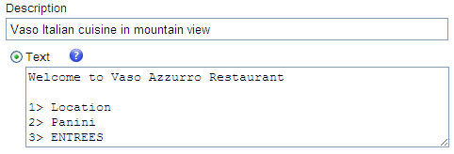
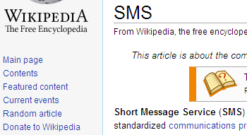
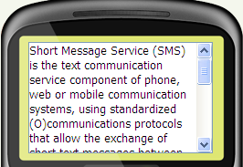
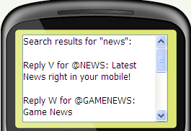
How does txtWeb solve the problem?
What to SMS
To 917 300 0111 (US);
92433 42000 (India)
1
Authoring tool for new content. Create a text site in just 5 minutes!
@vaso
2
APIs for repurposing existing web content or create new services
APIs
@wikipedia SMS
3
Menu based navigation. No need to remember any command!
Easy discovery via search, standardization and a one-stop shop for all services
news

Slide 5
txtWeb is first of its kind in several ways
100% reach
Works on all phones and all networks. Does not require a data plan.
Democratizes access down to the lowest common denominator: simplest cheapest phone in the remotest village of India
Pull-based
Users "pull" information when they want it, like the Web (NOT when sender wants to “push” it to the receiver)
Empowers users & respects their choices on when/what to receive
Free
There are no charges
Just pay the standard SMS cost as per your carrier plan, when pulling the information from txtWeb
Open platform
Anyone can put their content and services on txtWeb to make it accessible to billions. Like the Web, it is vertical agnostic.
So easy that 80% of current apps built by college students
Fastest
Creating a txtSite takes 5 minutes, creating a txtApp takes 5 hours
250 individuals & organizations have put their services on txtWeb and more are getting added each day

Slide 6
What type of apps can I build on txtWeb?
txtSite
Static and structured content
Published as information on SMS
Zero Code
Examples: Restaurant menu/timings, list of holidays
txtApp
Dynamic content
Personalized and user session based
Implemented as a standard web-based application
Programming language independent
Push Capability
Examples: Multi-party SMS chat app, a poll app, status update Twitter/Facebook

Slide 7
Demo Illustrative apps out of 1000+ currently live
Student: @WIKIPEDIA SMS, @WORD Pamper
Urban youth: @MOVIES, @LYRICS
Farmer: @MBUZZ, @WEATHER
Small business owner: @VASO, @PUJA, @MANJUTEA
Tier-2/3 town residents: @DTC, @NEWS, @TAXREFUND
For all: @EYEBANK, @MYPNR, @PASSPORT, @CRICKET, @CRICBUZZ

Slide 8
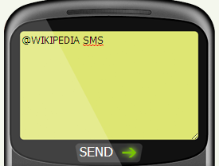
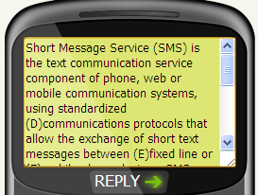
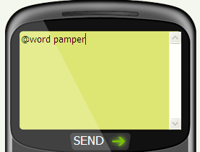
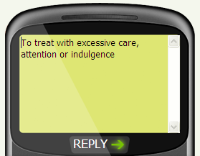

Slide 9
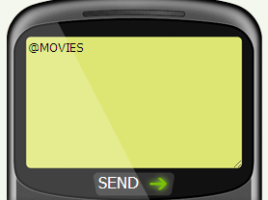
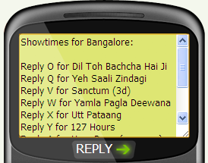
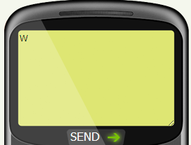

@MOVIES for local show times
1
2
3
4

Slide 10
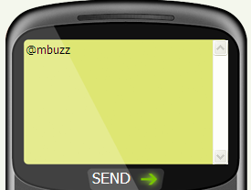
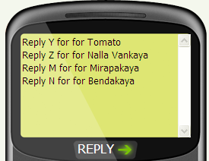
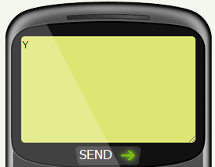
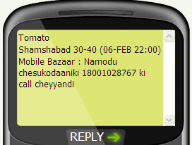
@MBUZZ for farm prices
1
2
3
4

Slide 11
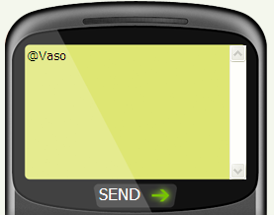
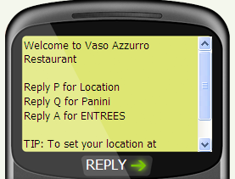
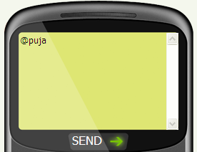
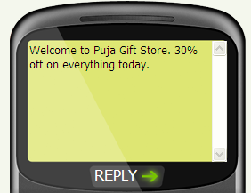
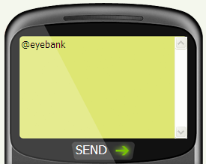
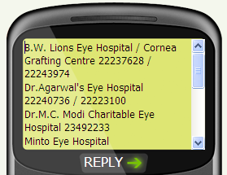

Slide 12
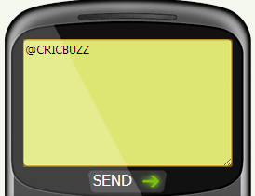
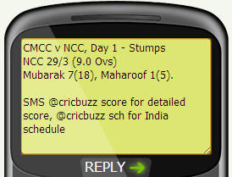
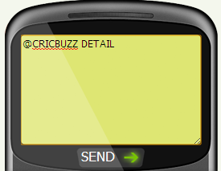
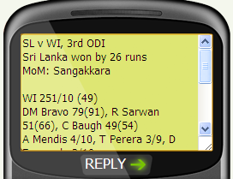
@CRICBUZZ for cricket score
1
2
3
4

Slide 13

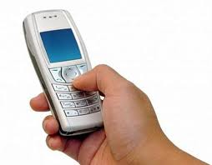

txtWeb platform – How it works
txtWeb
Platform
Phone Carrier
Internet
SMS
SMS
HTTP
HTTP
Developer APP

Slide 14
txtWeb platform – Example
Step1: SMS to 92433 42000
Message: @word intuition
Mobile number : 9991211212
Step 2: Accepts keyword and invokes the App URL
Step 3: HTTP Request: GET
URL:/dictionary? Txtweb-message=intuition& Mobile number: <hash>
Step 4. App
Specific logic
Developer App
txtWeb
Platform
Phone Carrier
Internet
SMS
SMS
HTTP
HTTP
Externally Hosted Environment
Step 6: SMS to 9991211212
Immediate cognition without the use of conscious rational processes
Step 5: HTTP RESPONSE: 80
<html> intuition
Immediate cognition without the use of conscious rational processes</html>

Slide 15
Platform advantages
Simple, easy, open API
Platform is programming language agnostic (use what you fancy – Java, PHP, Perl, Python)
Platform provides SMS ⇌ HTTP transformation
Makes developer’s life simple for delivering web app over SMS
Developer focuses on building an HTTP based app
No coding work to “integrate” with txtWeb platform
Rapid development – Build, test and go live in no time!
Emulator provides easy/instant testing
Nothing to download for an end-user to use your app – SMS and go!

Slide 16
Constructing HTML responses
txtWeb Responses /Interactions can be of 3 types
txtWeb Menu (akin to an list box)
Text input from the user (akin to a text box)
Embedded links in the message (akin to hyperlinks )

Slide 17
txtWeb Menu
The platform takes care of session management
Options are shown as letters of the English alphabet
The option to be shown to the end user has to be embedded within HTML links (ahref tags)
The option is preceded by class description as < class=“txtweb-menu-for” > tag to let the platform recognize that it is a menu item

Slide 18
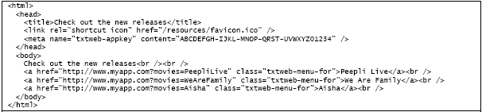
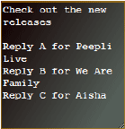

Slide 19
Getting Input from the User
Construct a simple HTML form
Have a text box to accept input
Have a small submit button
The input accepted by the text box is converted to an option on the mobile to accept input from the end user
The submit button translates to sending the input to the app
The input instruction is preceded by class description as “<txtweb-form>” tag to let the platform recognize that it is a menu item

Slide 20
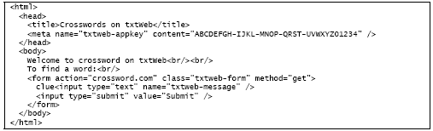
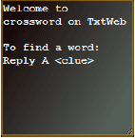

Slide 21
txtWeb Links
Very similar to having href link in a html page
The URL is surrounded by href tags.
The platform removes the href tag and replaces an option against the word.

Slide 22
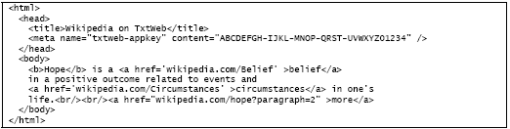
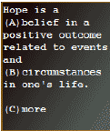

Slide 23
PUSH service implementation
txtWeb PUSH service can be used to
Push notifications to end users
Send alerts and reminder
Act as channels to users post registration

Slide 24
How to implement PUSH?
Make a HTTP post request using the API –
- http://api.txtweb.com/v1/push
Three parameters to be passed-
txtWeb-mobile
txtWeb-pubkey
txtWeb-message
txtWeb-mobile works for numbers which have used txtWeb at least once and haven’t opted out of the service.
txtWeb message has to be URL encoded
Response is returned as XML – 0 denotes success

Slide 25
Q&A

